Slide 1


CORPORATE DECK
February 2019
LeanLife Health Inc.
CSE: LLP
Last price: $0.085
Market cap: $8M
As of February 26, 2019

Slide 2
DISCLAIMER
This presentation is not, and nothing in it should be construed as, an offer, invitation or recommendation in respect of LeanLife's securities, or an offer, invitation or recommendation to sell, or a solicitation of an offer to buy, the facilities or any of the Company’s securities in any jurisdiction. Neither this presentation nor anything in it shall form the basis of any contract or commitment. This presentation is not intended to be relied upon as advice to investors or potential investors and does not take into account the investment objectives, financial situation or needs of any investor. All investors should consider such factors in consultation with a professional advisor of their choosing when deciding if an investment is appropriate. The Company has prepared this presentation based on information available to it, including information derived from public sources that have not been independently verified. No representation or warranty, express or implied, is provided in relation to the fairness, accuracy, correctness, completeness or reliability of the information, opinions or conclusions expressed herein. These projections should not be considered a representation of the Company’s potential cash generation performance in any way. The financial information included in this presentation is preliminary, forward-looking, unaudited and subject to revision. All forward–looking statements attributable to the Company or persons acting on its behalf apply only as of the date of this document, and are expressly qualified in their entirety by the cautionary statements included elsewhere in this document. The financial projections are preliminary and subject to change; the Company undertakes no obligation to update or revise these forward–looking statements to reflect events or circumstances that arise after the date made or to reflect the occurrence of unanticipated events. Inevitably, some assumptions will not materialize, and unanticipated events and circumstances may affect the ultimate financial results. Projections are inherently subject to substantial and numerous uncertainties and to a wide variety of significant business, economic and competitive risks, and the assumptions underlying the projections may be inaccurate in any material respect. Therefore, the actual results achieved may vary significantly from the forecasts, and the variations may be material.
Copyright © 2019 LeanLife Health Inc.
Investor relations contact
Stan Lis
+1 604 764 0518
slis@leanlifehealth.com
PLANT-BASED OMEGA PRODUCTS FOR EVERYDAY USE
2

Slide 3
OVERVIEW
LeanLife Health is a publicly listed (CSE: LLP) Canadian firm that specializes in creating
plant-based Omega-3 products for everyday use through proprietary technology.
LeanLife products are extracted from flaxseed for commercial food processors.
Key LeanLife advantages include:
  Long shelf life of 2+ years with oxidation resistance, ensuring long-term quality
  Thermal stability ensures products can be used in baking and freezing.
  Flavourless and tasteless - can be added to a large spectrum of foods
  Available in various product types such as oil, emulsion or powder
  High omega-3 concentration that cannot be found in other plant-based sources
  Optimal Omega-3 to Omega-6 ratio: LeanLife products have a ratio of 3:1, whereas the typical North American diet ratio is between 1:20 and 1:50.¹
References
Major Trouble Ahead If You Don't Fix Omega-3 Fat Deficiency. Published January 12, 2012. https://articles.mercola.com/sites/articles/archive/2012/01/12/aha-position-on-omega-6-fats.aspx
PLANT-BASED OMEGA PRODUCTS FOR EVERYDAY USE
3

Slide 4
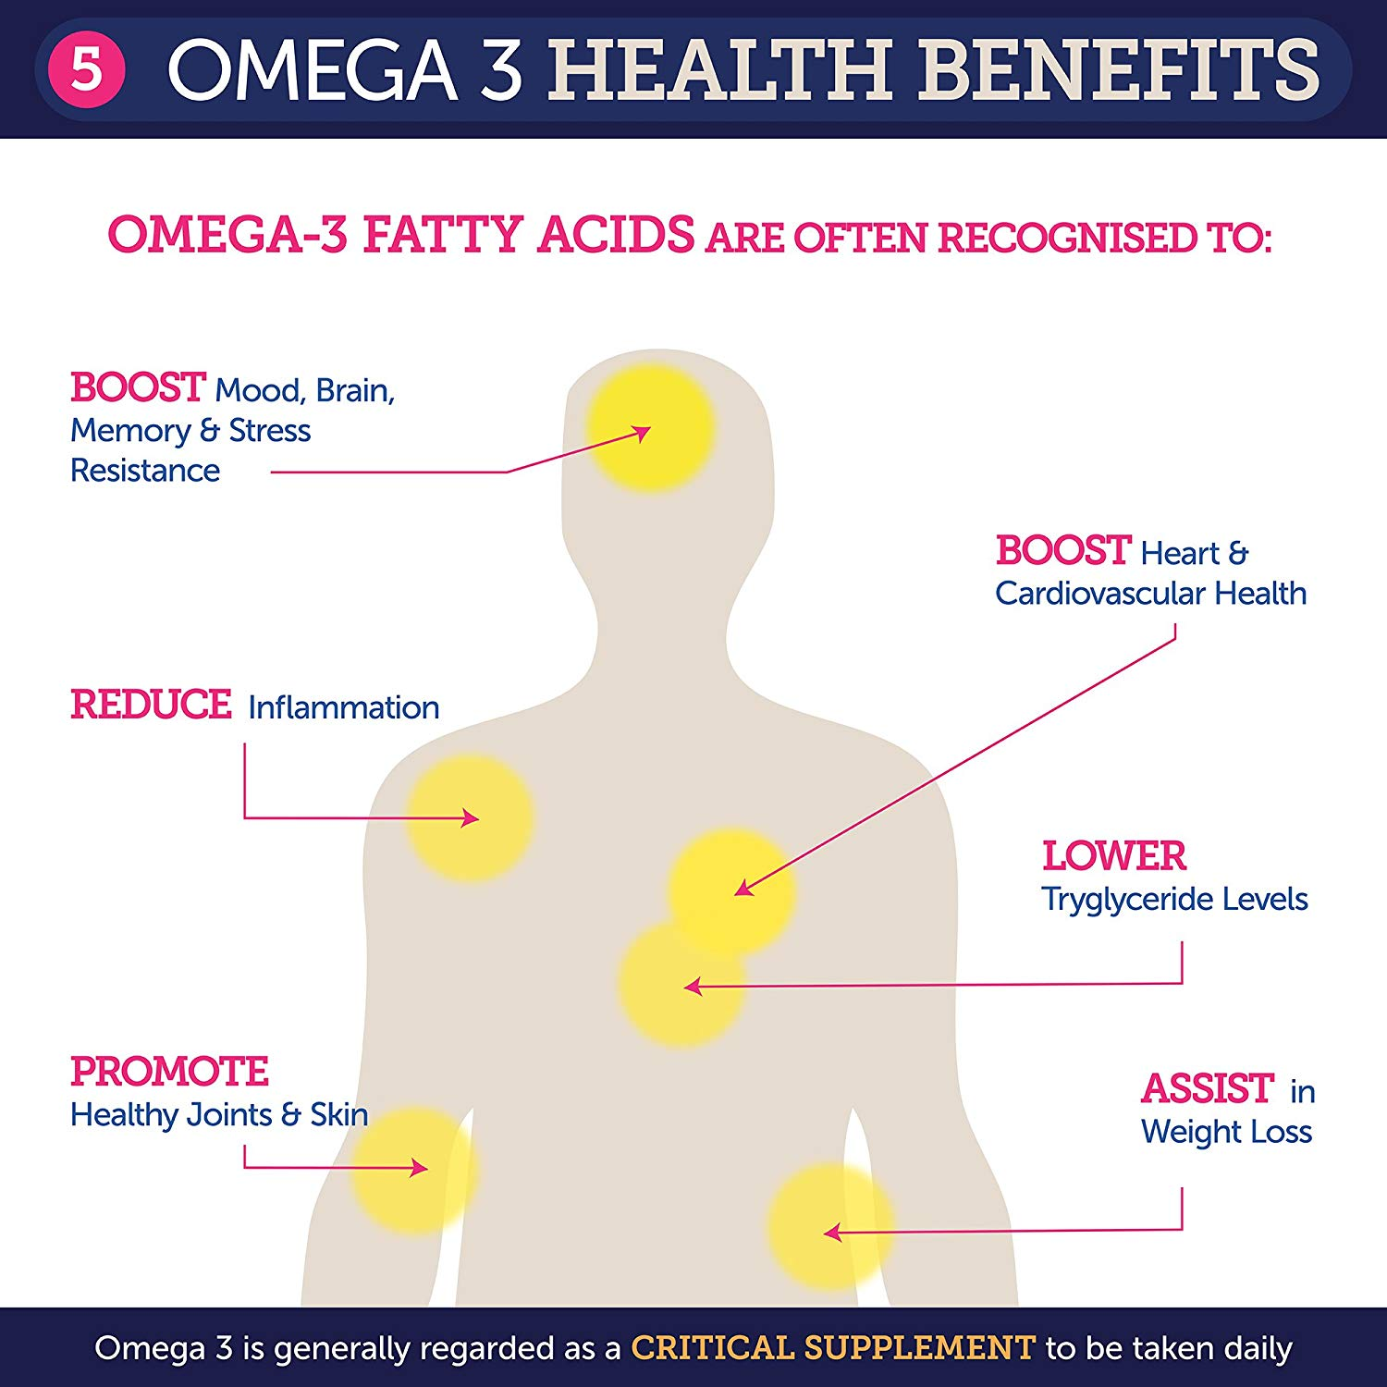
OMEGA-3
Omega-3 is an essential fatty acid that must be consumed through food and provides significant health benefits.
Most health organizations recommend a daily intake of Omega-3 (ALA): Women 1.1g/day (1/2 tsp) and Men 1.6g/day (3/4 tsp)¹. The average diet does not meet these levels for Omega-3 fatty acid intake².
Harvard School of Public Health: low Omega-3 intake is eighth on the list of most serious risk factors that contribute to death³.
References
Trumbo P, Schlicker S, Yates AA, Poos M (2002).Dietary reference intakes for energy, carbohydrate, fiber, fat, fatty acids, cholesterol, protein and amino acids; Food and Nutrition Board of the Medicine, The National Academies. J Am Diet Assoc 102(11).
U.S. adults are not meeting recommended levels for fish and omega-3 fatty acid intake: results of an analysis using observational data from NHANES 2003–2008. The Nutrition Journal. Published online, April 2, 2014. doi: 10.1186/1475-2891-13-31
The Preventable Causes of Death in the United States: Comparative Risk Assessment of Dietary, Lifestyle, and Metabolic Risk Factors. Published January 10, 2011. PLoS Med 8(1): 10.1371/annotation/0ef47acd-9dcc-4296-a897-872d182cde57.
PLANT-BASED OMEGA PRODUCTS FOR EVERYDAY USE
4

Slide 5
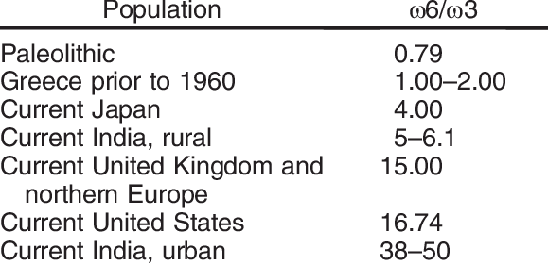
THE OMEGA-3/OMEGA-6 RATIO
Omega-3, -6 and -9 differ in function; Omega-6 and -9 are primarily used for energy, whereas Omega-3 is used for cell membrane function and other critical functions.
Higher Omega-6 relative to Omega-3 is associated with various health risks, such as obesity¹, systemic inflammation, digestive disorders, arthritis and depression².
While the optimal ratio is 1:3 – 1:5,³ this ratio has skewed towards Omega-6 as the Western diet developed, including increases in vegetable oils and grain-fed livestock.
References
The importance of the ratio of omega-6/omega-3 essential fatty acids. Published October 2002. PMID: 12442909
An Increase in the Omega-6/Omega-3 Fatty Acid Ratio Increases the Risk for Obesity. Published March 2016. PMID: 26950145
The importance of the ratio of omega-6/omega-3 essential fatty acids. Published October 2002. PMID: 12442909
Table source: The Importance of the Omega-6/Omega-3 Fatty Acid Ratio in Cardiovascular Disease and Other Chronic Diseases. Experimental Biology and Medicine. Published July 2008. DOI: 10.3181/0711-MR-311
PLANT-BASED OMEGA PRODUCTS FOR EVERYDAY USE
5

Slide 6
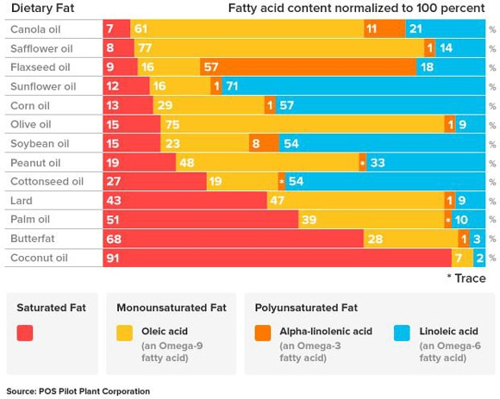
WHY FLAXSEED OIL?
LeanLife products are derived from high quality flaxseed oil, which yields the highest Omega-3 concentration of any plant source.
Consumption of fish oil has been linked to mercury and selenium intake through fish contamination¹ with the EU warning that it can inhibit children’s development².
Flaxseed ranks level 1 on the trophic food chain vs. level 3 or 4 for fish-based Omega-3, ensuring higher environmental sustainability.
References
Mercury, selenium and fish oils in marine food webs and implications for human health. Journal of the Marine Biological Association of the United Kingdom. Published February 2016. doi: https://doi.org/10.1017/S0025315415001356
Questions and answers: EU mercury policy and the ratification of the Minamata Convention. Published May 18, 2017. http://europa.eu/rapid/press-release_MEMO-17-1344_en.htm
PLANT-BASED OMEGA PRODUCTS FOR EVERYDAY USE
6
Notes:
European guidelines on consumption of marine fish – harmful to pregnant women and children of ages under 12 (second point)

Slide 7
THE LEANLIFE ADVANTAGE
Proprietary method to make safe form of Omega-3. Ethyl esters included in the LeanLife products are the only US FDA-approved source of Omega-3 essential unsaturated fatty acids that do not interfere with blood clotting, as some Omega-3 fatty acids from fish oil do.
Stability in character and taste. LeanLife Omega-3 does not have any taste and can be used in high-temperature (baking) or low-temp (frozen food) product offerings.
Highly concentrated Omega-3 intake. One 4 ml dose (less than a teaspoon) of LeanLife product contains 1760 mg of Omega-3, equivalent to eating 1 kg of cod fish.
Does not need refrigeration, preservatives and antioxidants, simplifying the food making process by make it less prone to oxidation, peroxidation, epoxidation, hyperoxide formation and the isomerisation processes.
PLANT-BASED OMEGA PRODUCTS FOR EVERYDAY USE
7
Notes:
Revised “equivalent” to remove comparison to capsules after discussion with Carl.
1 ml LeanLife Product = 440 mg of Omega-3 (ALA).
Need to be more precise with the “spoonful” diction / tbsp = 15ml, tsp = 5ml / Update with Stan’s feedback
Feb 15: Now updated to 4ml Based on Marcin files 2016 01 24.docx. Received from Russ on Feb 14.

Slide 8
LEANLIFE APPLICATIONS
LeanLife products can be used to make a variety of nutritious items:
  Food: Baked goods, sauces & dips, desserts, condiments, bars, cheese, butter, processed meats, noodles, infant formula
  Beverage: Milk, soymilk, juice, sports drinks, other ready-to-drink products
  Frozen: Ice cream, frozen dessert
  Dietary supplements: Emulsions, flavored liquids, softgel, gummies
Significant non-human applications include fortified pet food. Existing Omega-3 supplements for pets are in form of fish oil capsules, which are highly susceptible to inflammation¹.
References
How much omega-3 should I give my dog? Fish oil for dogs. https://iheartdogs.com/how-much-omega-3-should-i-give-my-dog-the-surprising-answer/
PLANT-BASED OMEGA PRODUCTS FOR EVERYDAY USE
8

Slide 9
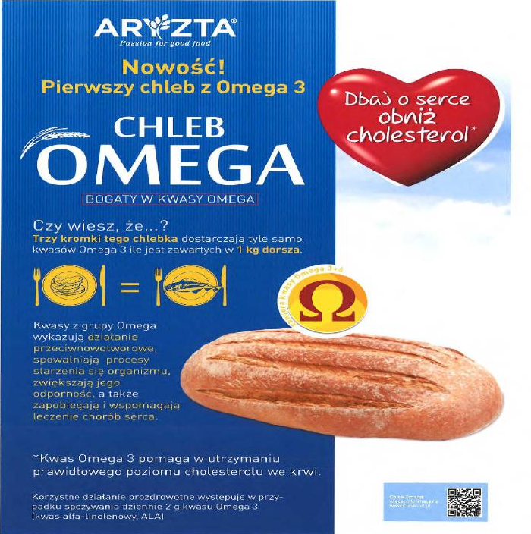
LEANLIFE IN ACTION
Translation of Polish to English:
Innovative
The first bread with Omega-3
Take care of your heart, lower cholesterol *
Omega Bread
Rich in Omega
Do you know that...
Three slices of this bread provide as much omega 3 as contained in 1 kg of cod
Omega acids anti-tumoral action slow down the aging process of the organism, increase its resistance and prevents and supports the treatment of heart disease
*Omega-3 acid helps maintain normal blood cholesterol levels
Preferred health-promoting effect is obtained with a daily consumption of 2 g of Omega-3 (alpha-linolenic, ALA)
ARYZTA, a Zurich-based global bakery with $4.2 billion in revenues in 2017, experimented with LeanLife products in their bread, using innovation funding from the European Union.
PLANT-BASED OMEGA PRODUCTS FOR EVERYDAY USE
9

Slide 10
MARKET SIZE
Global fortified foods and beverages market:
$106 billion²
CAGR: 6.1%
Global pet food market:
$99 billion³
CAGR: 4.3%
Global omega-3 supplement market:
$33 billion¹
CAGR: 5.6%
LeanLife enjoys significant market size potential that disrupts existing industries.
References
2016 data. Global omega-3 supplement market size in 2016 and 2015 (in billion U.S. dollars). Statista. https://www.statista.com/statistics/758383/omega-3-supplement-market-size-worldwide/
2018 data. Global Fortified Foods and Beverages Market Size Analysis, 2018-2028. Bekryl. https://bekryl.com/industry-trends/fortified-foods-and-beverages-market-share-analysis
2022 estimate. Pet Food Market Size Worth $98.81 Billion By 2022 | CAGR 4.3%. Grandview Research. https://www.grandviewresearch.com/press-release/global-pet-food-market
PLANT-BASED OMEGA PRODUCTS FOR EVERYDAY USE
10

Slide 11



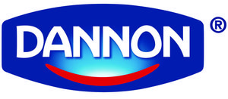


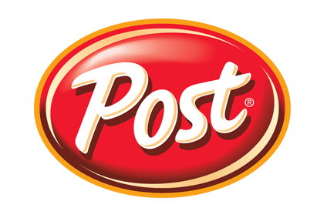




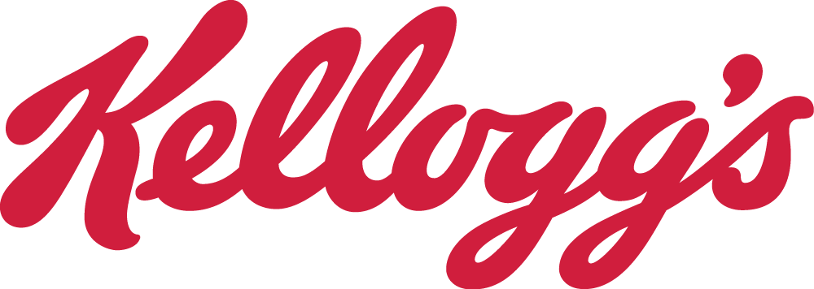
LEVERAGING RELATIONSHIPS
LeanLife has developed significant industry relationships through marketing activities and has ready access to a global base of customers.
PLANT-BASED OMEGA PRODUCTS FOR EVERYDAY USE
11

Slide 12
PRODUCTION
Present plans include operations out of Abbotsford, BC through a sub-lease.
  On February 25, 2019, LeanLife signed a Letter of Intent with Ecovatec Solutions, a local nutraceutical manufacturing company, to access its facilities to validate a new high-volume, high-efficiency sanitary manufacturing process and engage in initial production.
  Following a successful process trial, samples will be tested to ensure product quality, and then sent out to customers for their own quality assurance.
  Initial production will be based on a toll processing arrangement with LeanLife’s equipment, allowing for sales-optimized production ramp up, and delaying major capital expenditures.
  LeanLife also has an option for a long-term production arrangement which allows it to flexibly meet the short- and medium-term demand.
Optimized production levels are at 500 liters per hour, enabling 2,000 to 10,000 liters of output per day based on scalable operations of 4 to 20 hours per day.
PLANT-BASED OMEGA PRODUCTS FOR EVERYDAY USE
12
Notes:
If exceeding production capacity, new plant closer to the source of the flaxseeds

Slide 13
MARKETING
RD Heritage Group is a partnership of five family offices and their portfolio investments, with interests in food, real estate, pharmaceuticals, medical devices, biotech, solar energy, and in oil & gas exploration and production, with its roots at Famcor Oil and partnerships with Gulf-based sovereign wealth funds.
  Long history of licensing and commercializing drug and health products from University of California, Santa Barbara and Stanford Burnham Institute.
  Relationship can be re-established easily once funding is secured.
Tomasz Czarnocki is a dedicated sales executive based in Poland with experience in selling food products and B2B business market development.
PLANT-BASED OMEGA PRODUCTS FOR EVERYDAY USE
13

Slide 14
FINANCIALS
PLANT-BASED OMEGA PRODUCTS FOR EVERYDAY USE
14

Slide 15
USE OF FUNDS
LeanLife intends to raise $2.5 million to fund the following items:
PLANT-BASED OMEGA PRODUCTS FOR EVERYDAY USE
15

Slide 16
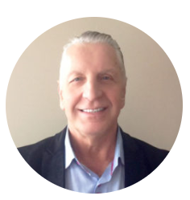


TEAM
Stan Lis
Chief Executive Officer
Mr. Lis was the co‐founder, past president and director of MicroCoal Technologies Inc. (formerly Carbon Friendly Solutions Inc.) from its inception in 2006 to 2015. From 2000 until 2006, he was the president, CEO and director of Stream Communications Network & Media Inc., a cable company where he was directly responsible for taking the company from start up to 65,000 subscribers. From 1993 until 2000, Mr. Lis acted as President, CEO and director of Trooper Technologies Inc., an environmental company focused on waste management in Central Europe. In 1988 he founded International UNP Holdings Ltd., a Toronto Stock Exchange Investment Company used to acquire and finance privatized Polish state enterprises. Mr. Lis studied Business Administration and Securities at Simon Fraser University. Mr. Lis personally raised over $60 million to finance the above mentioned companies.
Jason Tong, CPA, CA, CFA
Chief Financial Officer
Mr. Tong has over a decade of experience providing accounting, tax, corporate advisory, and CFO services to private and public companies in the technology, manufacturing and distribution, finance, and mining sectors. Previously, Mr. Tong was the chief financial officer of Pathway Capital Ltd, a venture capital group with a portfolio of early-stage ventures with market caps ranging from $5 million to $100 million. He was also CFO at Turnberry Resources Ltd from February 2012 until it was acquired in April 2014.
Carl F. Perez, PhD
Chief Technical Officer
Dr. Perez has more than 30 years of leadership in academic research programs and has experience in all phases of drug discovery, process development, preclinical development, FDA/Health Canada regulatory compliance, and cGMP manufacturing. Dr. Perez was Director Preclinical Programs for Chromos Molecular Systems (Burnaby, BC) and VP Product Development for Metaara Medical Technologies (Vancouver, BC).
PLANT-BASED OMEGA PRODUCTS FOR EVERYDAY USE
16

Slide 17
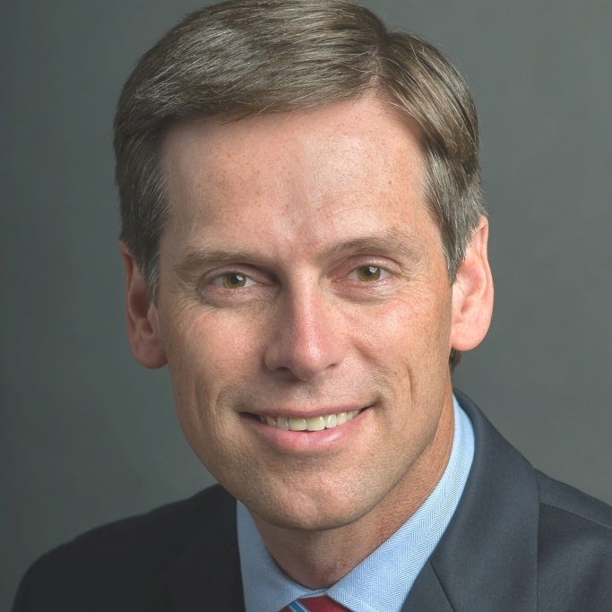
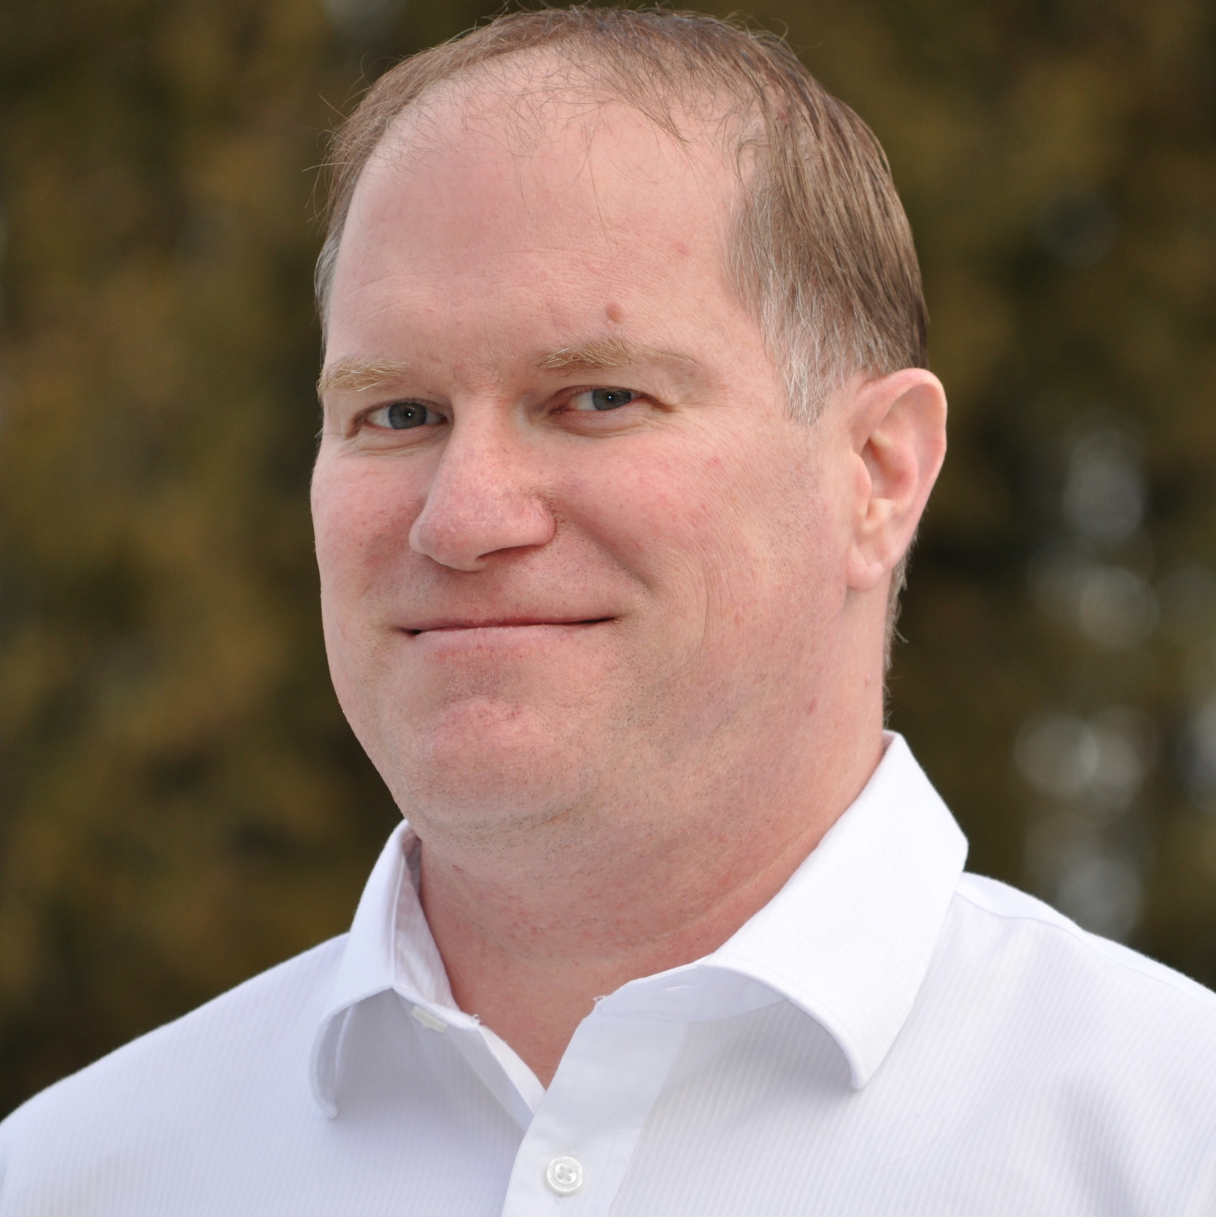
TEAM
Russ Hiebert
Corporate Advisor
Mr. Hiebert served as a Member of Parliament in Canada for eleven year (2004-2015) before choosing to return to the private sector. During his time in office he was appointed Parliamentary Secretary for Defense and later Intergovernmental Affairs. He also served on the Natural Resources, Finance and International Trade committees. As Canadian Chairman and Representative on the 53-nation Commonwealth Parliamentary Association (Her Majesty Queen Elizabeth II as Patron); leadership roles on many other international associations; speaking engagements at the European Parliament and at the United Nations as well as experience in over 100 nations, Mr. Hiebert has developed a worldwide network of contacts in business and foreign governments. He has the ability to connect people with key decision makers, joint venture partners and investors, for the purpose of developing trade and other business opportunities. He began his education in the Faculty of Engineering before completing a multi-faceted undergraduate degree in Los Angeles, California that included studies at Oxford University and an internship at the Canadian Embassy in Washington, DC. He earned his Law Degree at the University of British Columbia (UBC) and the University of Sydney (Australia), then practiced as a lawyer at a national Canadian law firm, before completing his Master’s Degree in Business Administration (MBA) also from UBC. He has completed the Institute of Corporate Directors Education Program and has served as a director on a variety of private and public companies.
Glenn Nichols
Operations Manager
Glenn brings more than 15 years of Product and Project Management experience working with large multi-company teams combined with a strong automation engineering background. Over the past several years he has played key roles in the nutraceutical market bringing a manufacturing plant operational while automating several of its complex processes to maximize efficiencies, reduce labour requirements and improve product quality and consistency. One of Glenn's primary strengths is his ability to identify problems with current or planned products and processes. His creative solutions have resulted in him being named in several patents granted, pending or in the application stage for every company he has worked with over the past 18 years.
PLANT-BASED OMEGA PRODUCTS FOR EVERYDAY USE
17

Slide 18
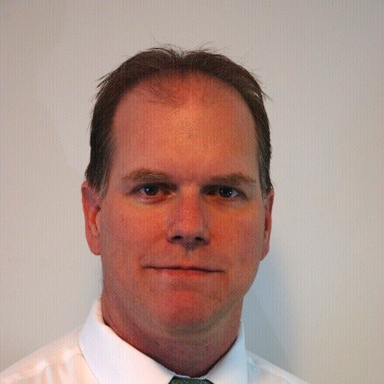
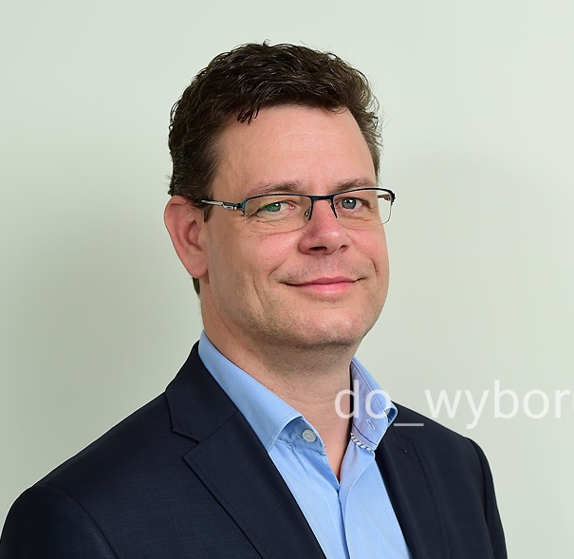
TEAM
Chris Nichols
Advisor
Chris has over 25 years of operations leadership experience in food-based fast moving consumer goods manufacturing with several large multi-national companies such as COCA-COLA and MOLSON COORS. Holding a BSc from Simon Fraser University combined with technical work experience in processing line design, optimization and operation, including aseptic processing makes him a great resource in the development of our facility. Chris also has a strong background in HACCP and GMP food safety systems and experience in building these foundations into the process line’s physical and operational design at early stages. Using Lean Six Sigma tools and training, Chris has implemented process improvement and optimization in every position he has held leveraging that into multiple millions in annualized cost savings in addition to managing dozens of capital projects from design through to completion, on time and on budget, while meeting all the project deliverables.
Tomasz Czarnocki
Sales Manager, Europe
Tomasz has been selling LeanLife products in Poland for several years. His main customer has been the Polish branch of Switzerland-based Aryzta. Mr. Czarnocki also has been Sales Director of Libra Polska Sp z o.o. and Fabryka Aromatów Sp.z o.o. since April 2011 where he has been responsible for business development in the B2B market, developing sales strategy and plans, and implementing working system analysis of managers, sales representatives, technologists and customer service representatives.
PLANT-BASED OMEGA PRODUCTS FOR EVERYDAY USE
18

Slide 19
BOARD OF DIRECTORS
Marcin Łukaszewicz, PhD
Dr. Łukaszewicz is the Dean of the Department of Biotransformation, at the Faculty of Biotechnology, University of Wroclaw (Poland). Dr. Łukaszewicz is an expert in molecular biology, biotechnology, and microbiology.
Glen Macdonald
Mr. MacDonald is a self-employed geology consultant. Mr. Macdonald has served as CEO, President, and Director for numerous private and public companies with particular expertise in corporate development and fiduciary compliance.
Robert Chanson, PhD
Dr. Robert Chanson is a Swiss National born in Sri Lanka (1950). Following schooling in Ceylon and Switzerland, he studied Law & Ecology in Zurich, London and Paris. Robert is a Lawyer and holds a PhD in Environmental Sciences. Following a career in various management capacities with an internationally operating Swiss financial services Company he formed a pioneering risk-management company with a focus on environmental risks in the early 90s. Since the late 90s Robert has established himself as an Institutional Business Angel in the field of Biotech, Sustainable Agriculture and Renewable Energies entertaining projects both in Europe, North America and South Asia. He is a co-founder of the London-listed ag-biotech Company ‘Plant Health Care’ – his two latest start-ups focus on encryption technologies and a novel pyrolytic reactor. Dr. Chanson has joined the LeanLife team as an Independent Director to assist the Company in reaching its ambitious business goals in North America and overseas.
Stan Lis
Chief Executive Officer, LeanLife Health
PLANT-BASED OMEGA PRODUCTS FOR EVERYDAY USE
19

Slide 20
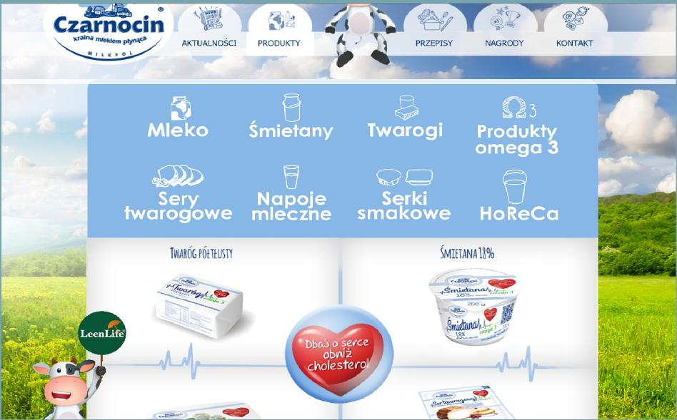
LEANLIFE OMEGA-3 CHEESE
PLANT-BASED OMEGA PRODUCTS FOR EVERYDAY USE
20

Slide 21
REGULATORY REQUIREMENTS
Safe Food for Canadians Regulations (SOR/2018/108)
  Going into effect Jan. 15, 2019, the new regulations govern the handling and processing of all foods produced within Canada to ensure food safety.
  LeanLife Health will be producing all its products in facilities in compliance with these regulations to ensure the highest quality is maintained such as is expected internationally of Canadian food producers.
HACCP (Hazard Analysis and Critical Control Points)
  HACCP is an internationally recognized systematic preventive approach to food safety from biological, chemical, and physical hazards in production processes that can cause the finished product to be unsafe and designs measures to reduce these risks to a safe level.
  In order to ensure LeanLife products are marketable globally, it will be following the ISO 22000 FSMS 2011 standard and seeking independent 3rd party certification to ensure compliance of its Total Quality Management system.
PLANT-BASED OMEGA PRODUCTS FOR EVERYDAY USE
21

Slide 22
INVESTOR MEMORANDUM
February 2019
LeanLife Health Inc.
CSE: LLP
Last price: $0.085
Market cap: $8M
As of February 26, 2019

